Slide 1

KALERWE
S.D.A Hymnal 341
4 ~ Verses
8.
Okukaaba Kwange Owulire…
~
O hear My Cry…

Slide 2
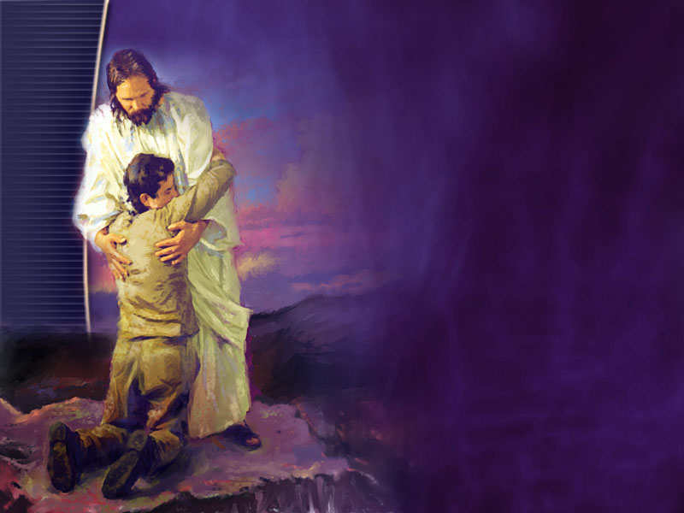
1 of 4 verses
Okukaaba kwange owulire,
Jjangu omulokozi;
Omwoyo gwange gukwetaaga nnyo,
Jjangu omulokozi.

Slide 3
1 of 4 verses
CHORUS:
Nakyama okuva mu kkubo lyo,
Mbulubutira mu ddungu;
Ntwala onzize mu kisibo kyo,
Jjangu omulokozi.

Slide 4
2 of 4 verses
Sirina buddukiro bulala,
Jjangu omulokozi;
Amaaso go ge gampa (o)bulamu,
Jjangu omulokozi.

Slide 5
2 of 4 verses
CHORUS:
Nakyama okuva mu kkubo lyo,
Mbulubutira mu ddungu;
Ntwala onzize mu kisibo kyo,
Jjangu omulokozi.

Slide 6
3 of 4 verses
Ekkubo limbuze, nkoye nnyo,
Jjangu omulokozi;
Era (e)ssuubi lyange lizirika,
Jjangu omulokozi.

Slide 7
3 of 4 verses
CHORUS:
Nakyama okuva mu kkubo lyo,
Mbulubutira mu ddungu;
Ntwala onzize mu kisibo kyo,
Jjangu omulokozi.

Slide 8
4 of 4 verses
Togobanga mmeme emenyese,
Jjangu omulokozi;
Onokiriza (o)kusaba kwange,
Jjangu omulokozi.

Slide 9
4 of 4 verses
CHORUS:
Nakyama okuva mu kkubo lyo,
Mbulubutira mu ddungu;
Ntwala onzize mu kisibo kyo,
Jjangu omulokozi.

